Slide 1

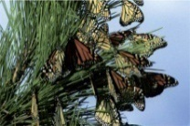


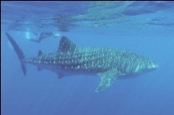

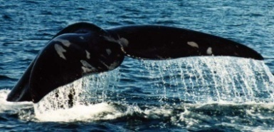
Convention on Migratory Species
-Americas Flyways Workshop-
15 January 2014
Monika Thiele
North American Focal Point
United Nations Environment Programme/ Convention on Migratory Species

Slide 2
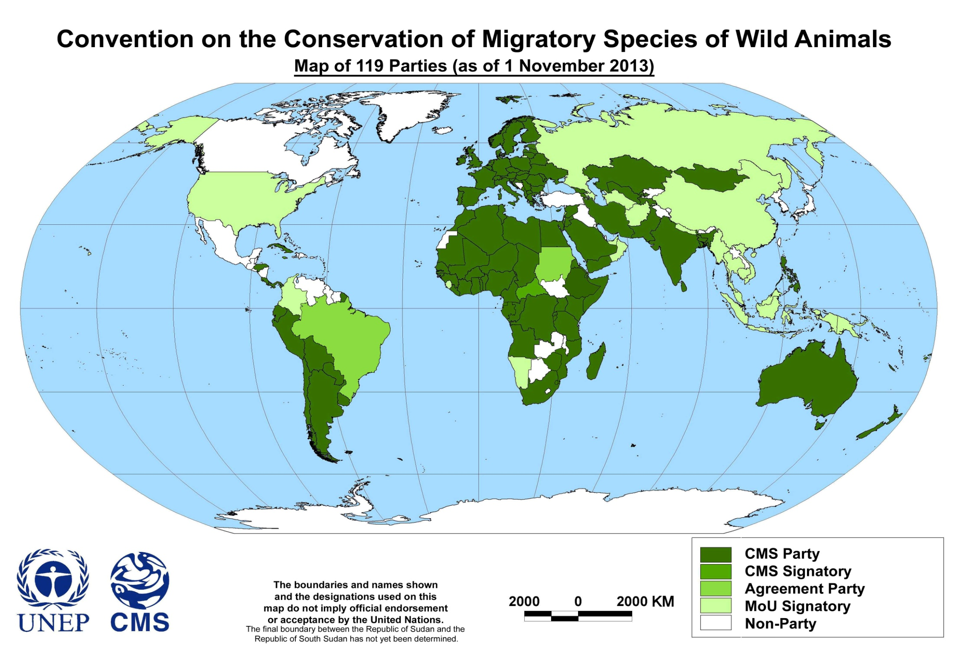
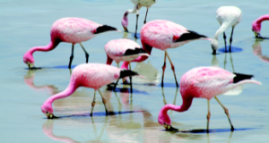

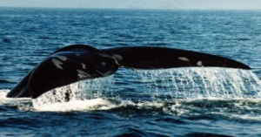

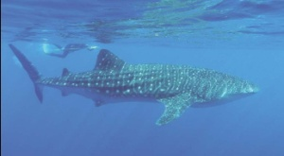


Slide 3
Legal
Framework
Non- Legally Binding
Legally Binding
Aquatic Warbler
Bukhara Deer
Dugong
Great Bustard
Wadden Sea Seals
ACAP
EUROBATS
ACCOBAMS
Pacific Cetaceans
Raptors
Ruddy Headed Goose
Saiga Antelope
ASCOBANS
Gorilla
AEWA
Sharks
Siberian Crane
Slender-billed Curlew
West African Aquatic Mammals
High Andean Flamingo
Marine Turtles Africa
IOSEA
Mediterranean Monk Seal
West African Elephants
Grassland Birds of South America
Central Asian Flyways A.P..
C. Eurasian Aridland Mammals AP

Slide 4
CMS MoUs in North America
Ruddy-Headed Goose MoU
  The MoU between the Argentine Republic and the Republic of Chile on the Conservation of the Ruddy-headed Goose (Chloephaga rubidiceps) was concluded under CMS auspices and became effective on 21November 2006. It aims to safeguard the mainland population of this species, which is listed in the CMS Convention’s Appendices I and II.
High Andean Flamingos MoU
  An MoU aimed at improving the conservation status of the species and their habitats was concluded among the range states during COP9 on 4 December 2008.The populations of the two species of Andean Flamingos-- Phoenicopterus andinus and P. jamesi --are listed in CMS Appendix I.
Southern Grassland Birds MoU
  The MoU on the Conservation of Southern South American Migratory Grassland Bird Species and their Habitats was concluded under CMS auspices and became effective on 26 August 2007. Under the “umbrella“ of the Convention on Migratory Species, the governments of Argentina, Bolivia, Paraguay and Uruguay agreed to work together towards better conservation of migratory species of grassland birds of Southern South America

Slide 5
RESOLUTION 10.10: GUIDANCE ON GLOBAL FLYWAY CONSERVATION AND OPTIONS FOR POLICY ARRANGEMENTS
… contd
In partnership with existing flyway organizations and initiatives (esp. WHMSI), develop an overarching conservation Action Plan for migratory birds in the Americas, recognizing especially the established programmes of work and taking into account existing instruments;
Organize a workshop (resources permitting) to consider specific needs and possible mechanisms for implementation in the region
Potential for an instrument covering Austral migrants
Potential for an instrument covering western hemisphere birds of prey;

Slide 6
Flyways Working Group Mandate
COP 10 (Nov 2011) Resolution 10.10 recognized the excellent work of the Flyways Working Group over the last triennium and
Proposed the continuation of the open-ended Flyways Working Group to review relevant scientific and technical issues, international initiatives and processes, and to provide guidance and input to the conservation and management of flyways at global and flyway level during the intersessional period until COP11, as a basis for CMS policy on flyways; and
Further requests Parties to provide resources for this work.

Slide 7
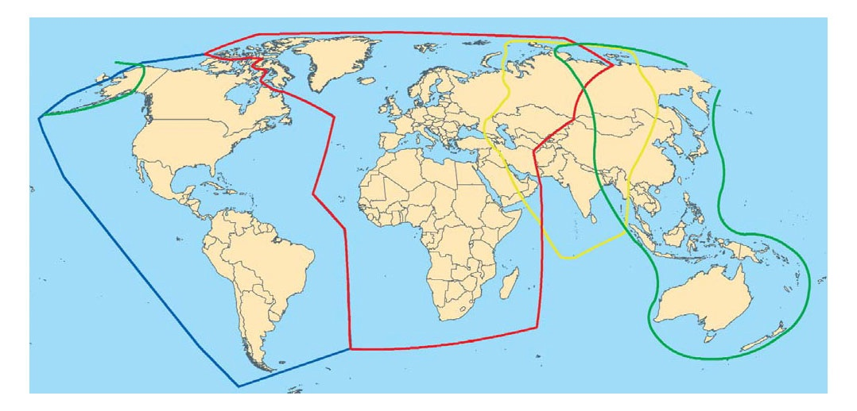




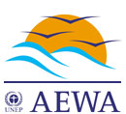






International frameworks
Raptor MOU
ACAP Treaty
Notes:
Globally policy instruments such as the CMS, Ramsar Convention and CBD make important contributions to international policy frameworks that support the protection of waterbirds. Good policy is essential to provide frameworks for action in support of biodiversity at different scales, and legally binding policies can be powerful and effective. The North American Waterfowl Management Plan has generated billions of dollars for waterbird and wetland conservation and resulted in the protection of over 120,000 square km of wetlands, benefitting birds and people. In Europe, the Bern Convention and European Union’ s Birds Directive provide a strong basis for conservation, the latter requires member states to designate protected areas and protect threatened species. The effectiveness of these instruments is one of the principal reasons why waterbirds in North America and Europe enjoy a more favourable conservation status than anywhere else in the world.
The flyway approach is now well-established in the region covered by AEWA. A very effective project under AEWA, part-funded by the UNEP and GEF was the Wings Over Wetlands (WOW) Project. One major output was the Flyway Training Kit, designed for use particularly in Africa, the Middle East and Central Asia and available in a selection of languages.
There are many non-statutory instruments as well, and in the Asia-Pacific region, the Partnership for the East Asian-Australasian Flyway provides countries and other partners a mechanism for flyway cooperation in the face of big challenges in a region occupied by about half of the world’ s human population which is undergoing unprecedented (and many would say, unsustainable) economic development.

Slide 8


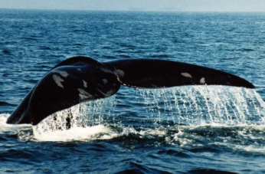
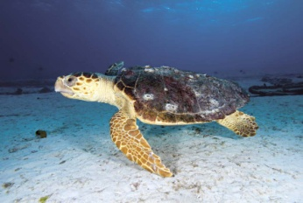


Activities Undertaken by FWG:
Produced the following reviews in 2010-2011:
Review 1: Existing CMS & Non CMS Agreements
Review 2: Knowledge of Flyways, Threats & Gaps
Review 3: Policy options and future actions

Slide 9
Contact Info:
Monika Thiele
Focal Point for North America
UNEP/CMS
Regional Office for North America
900 17th St. NW Suite 506
Washington, DC 20006 USA
Tel.: (+1 202) 974-1309 www.cms.int monika.thiele@unep.org

Slide 10
Presentation Outline
1. Overview of CMS -Mission & Legal Framework Slide & Role on WHMSI
2. Overview of Flyways Res 10.10 (major aspects related to Americas) Flyways Working Group
3. MOUs in NA (Andean Flamingo MOU & Grassland Birds MOU & Ruddy Headed Goose MOU)

